Slide 1

Do Tax cuts provide jobs growth?
Taniya Adhikari
DSC 530

Slide 2
"Our new Constitution is now established, everything seems to promise it will be durable; but, in this world, nothing is certain except death and taxes."
- Benjamin Franklin

Slide 3
Variables
LOCATION – This column provides the country’s information. For this Analysis I have narrowed it down to US Economic indicators and Japan’s Economic Indicators to compare both countries
YEAR – This variable is time in year.
CORPORATE TAX – Yearly Corporate tax for countries in percent total tax
INTEREST RATES – Yearly Interest rates for countries in percent per annum
UNEMPLOYMENT RATES – Yearly Unemployment rate in percent labor force
INCOME TAX RATES – Yearly Income tax rate percent total tax
GDP GROWTH – Yearly GDP USD per capita
CPI – Yearly Inflation index

Slide 4

Variables to Analysis
There are three variables that I will be looking at closely,
Unemployment rates
Corporate Tax rates and
CPI Index for inflation

Slide 5
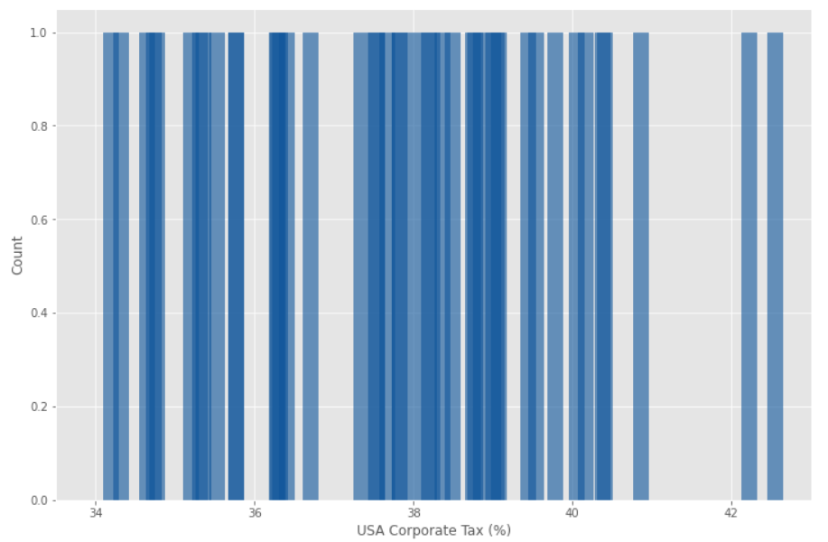
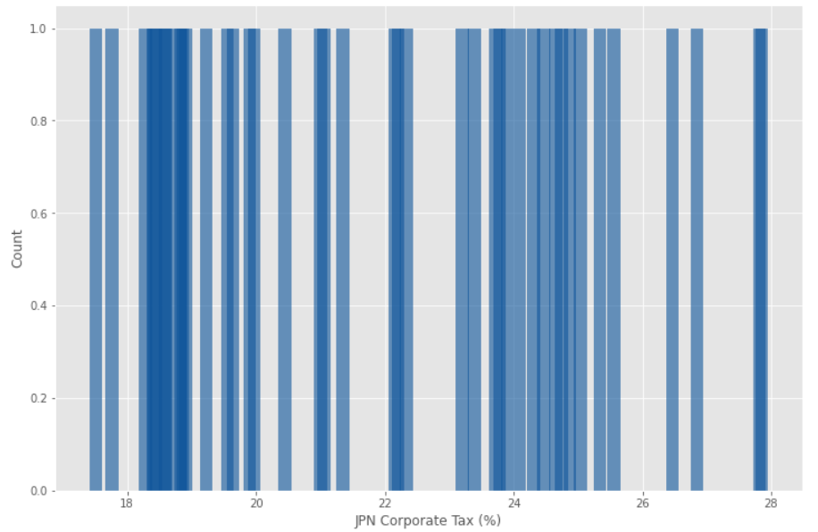
Corporate Tax

Slide 6
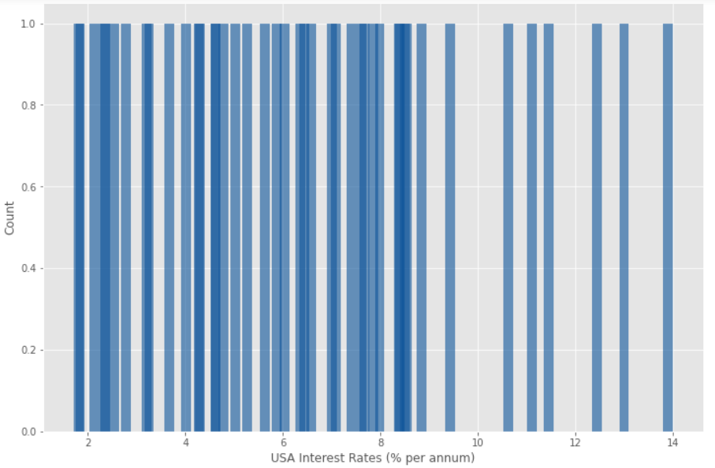
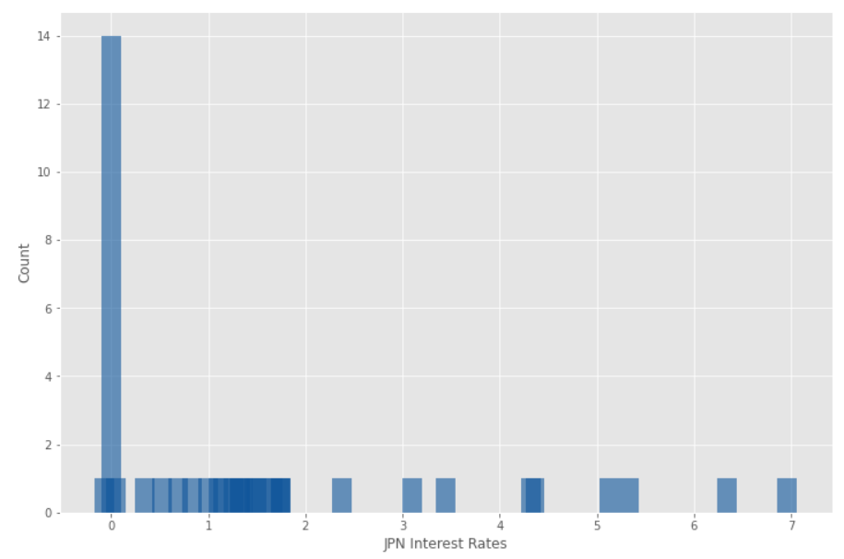
Interest Rates

Slide 7
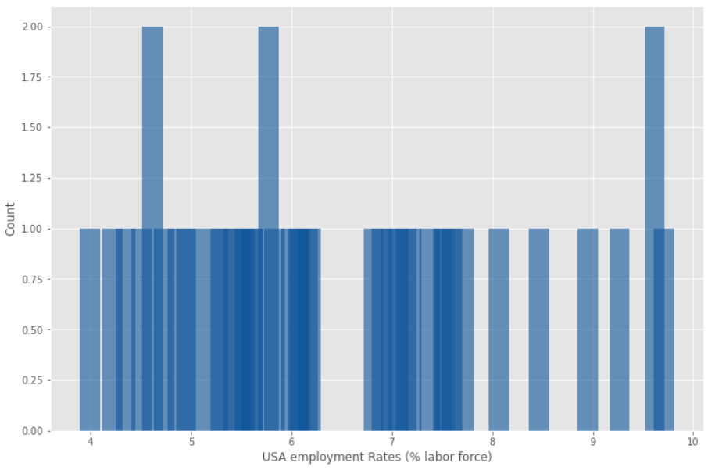
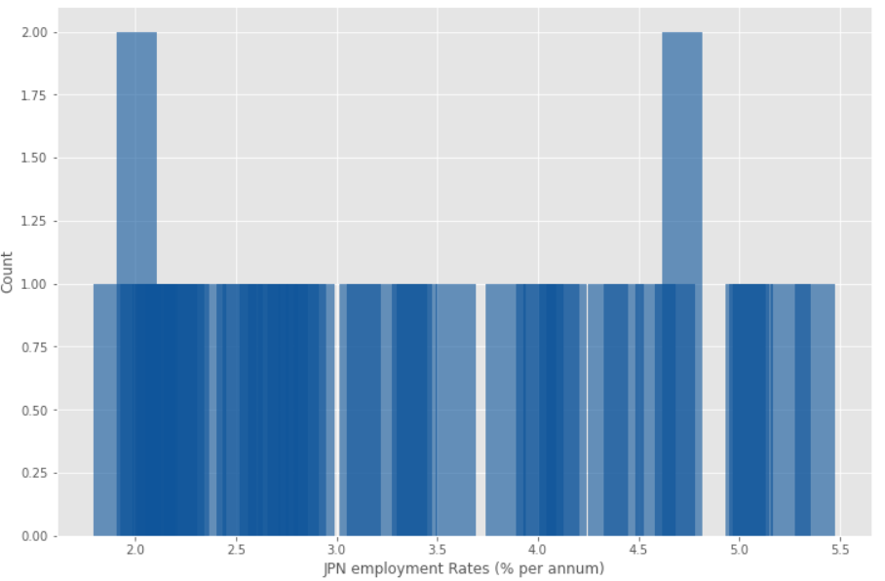
Unemployment Rates

Slide 8
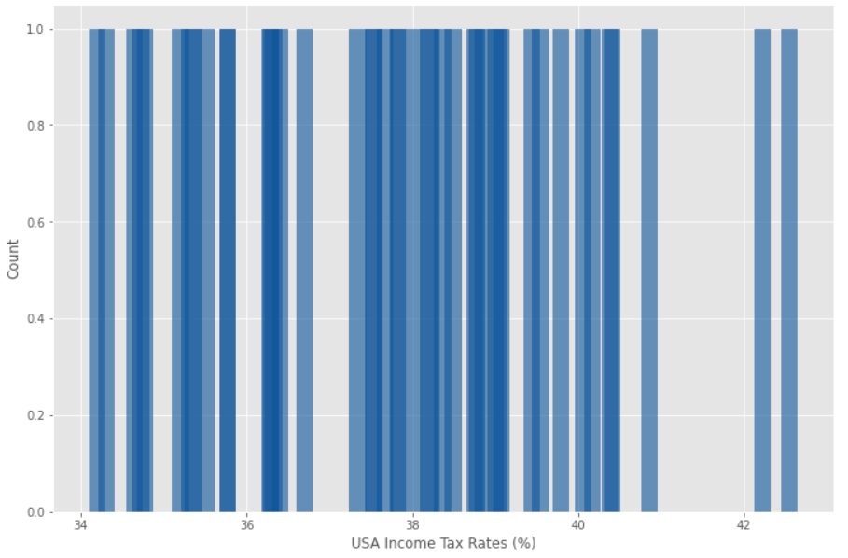
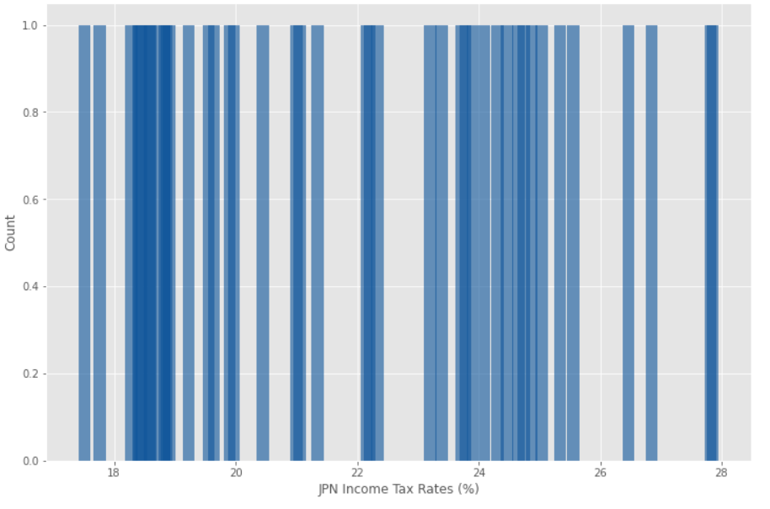
Income Tax

Slide 9
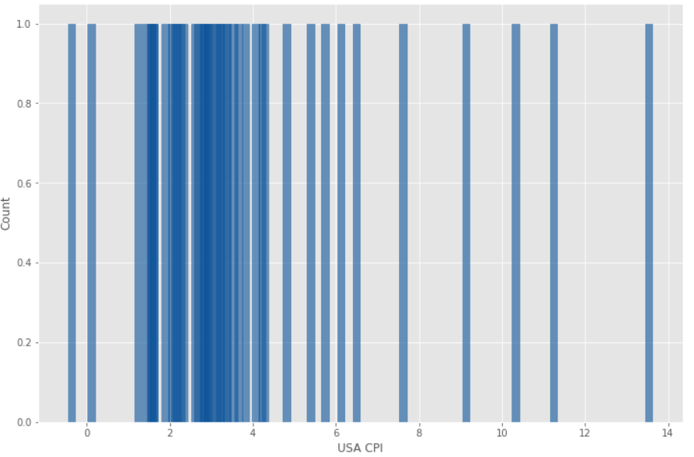
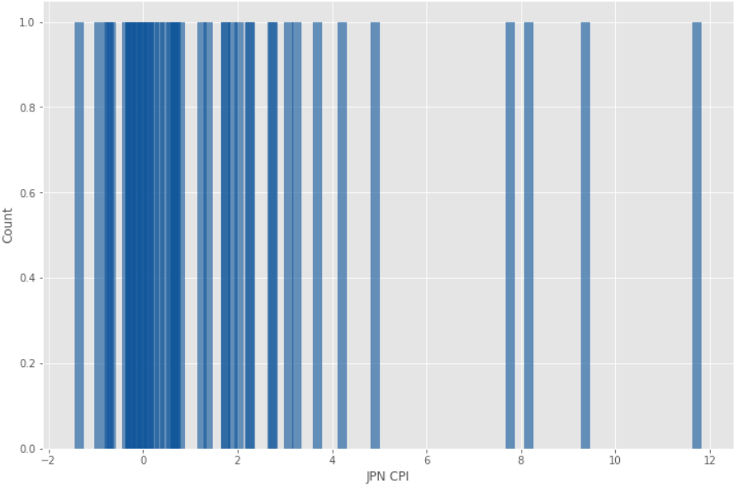
CPI

Slide 10
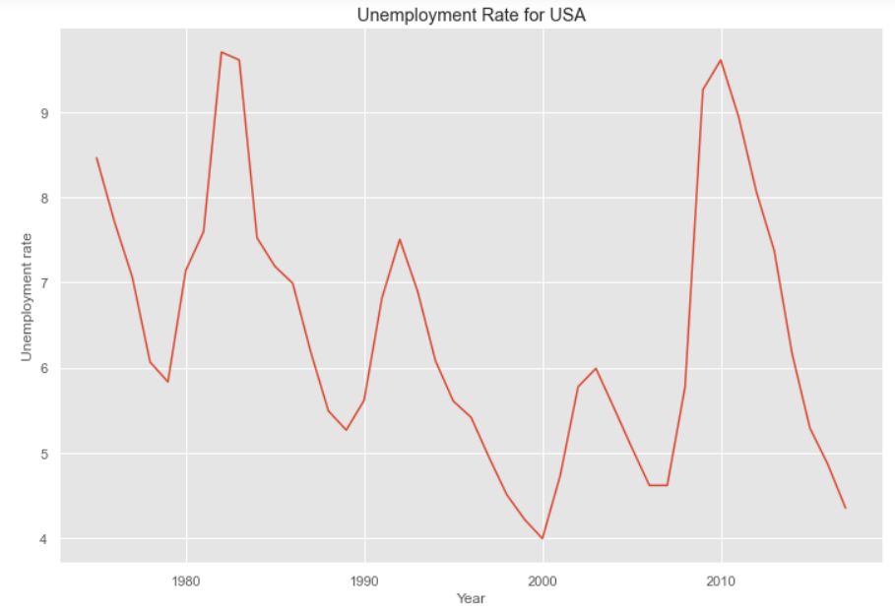
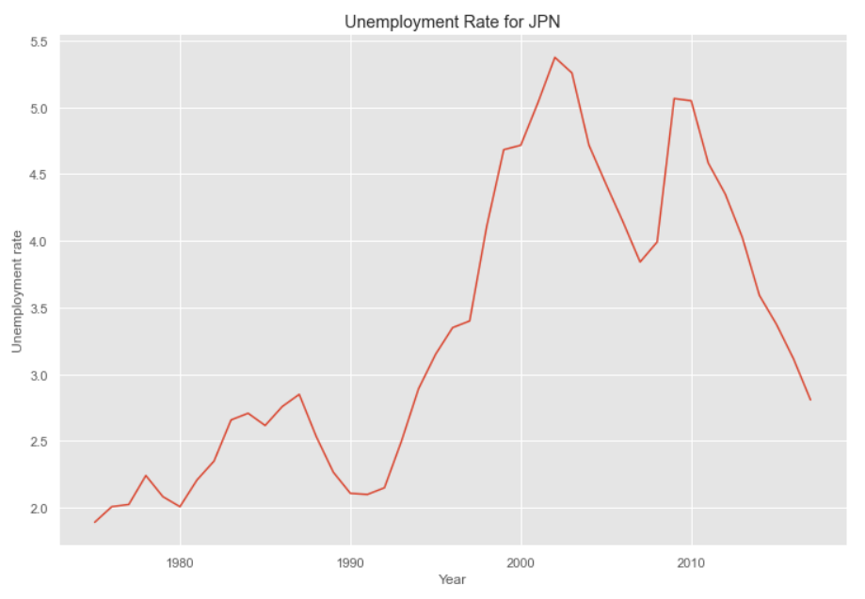
Unemployment Graph for Both Countries

Slide 11
Summary Analysis
All the economic indicators Corporate Tax, Interest Rates, GDP, CPI and Income Tax are close to being Uniform Distribution except for Unemployment rate for both countries.
There are few outliers but this is a Time series data, (even though, I am not doing Time series analysis), so all the value belong to a certain year. Considering Economic indicators moves with the economic changes, None of these values are unusual, in fact they have non-linear growth (refer to Unemployment rates line chart in Slide 10)
There are few missing values in Japan’s Interest Rates column which I turned into 0 instead of deleting it.

Slide 12
Summary Analysis - Continued
Mean for USA Corporate tax is 37.75% and Standard Deviation is 2.12%, median is 37.832% and mode is 34.648%. The Mean for Japan is slightly lower to 21.835% with standard deviations of 3.05%, median is 21.35% and mode is 23.90%. Cohen Effect Size is 6.045.The mean, median and mode are very close to each other, shows that data is uniform with histogram.
Mean for USA Interest Rates is 6.44% and Standard Deviation is 3.16%, median is 6.35% and mode is 7.987%. The Mean for Japan is quite lower to 1.48% with standard deviation of 1.855%, median is 1.1024% and mode is 0.0. Cohen Effect Size is 1.913. The mode and mean are different with mode being higher to 7.987, shows that there are different clusters.
Mean for USA employment rate is 6.408% and Standard Deviation is 1.57%,, median is 6.07% and mode is 9.616%. The Mean for Japan is slightly lower to 3.328% with standard deviation of 1.0944%, median is 3.11% and mode is 2.0%. Cohen Effect Size is 2.2722. The mode and mean are different with mode being higher for US and lower for Japan, shows that there are different clusters for both USA and Japan

Slide 13
Summary Analysis - Continued
Mean for USA income tax rate is 37.75% and Standard Deviation is 2.13%, median is 37.8% and mode is 34.648%. The Mean for Japan is slightly lower to 21.835% with standard deviation of 3.057%, median is 26.35% and mode is 23.90%. Cohen Effect Size is 6.046. The mode and mean are different with mode being lower for US and for Japan, shows that there are different clusters for both USA and Japan.
Mean for USA GDP is 31776.1 and Standard Deviation is 15662.8, the median is 29932.15 and mode is 7801.16. The Mean for Japan is slightly lower to 23464.06 with standard deviation of 11029.03, the median is 24524.09 and mode is 5250.24. Cohen Effect Size is 0.613635
Mean for USA CPI is 3.83 and Standard Deviation is 2.87, the median is 3.028% and mode is 9.14%. The Mean for Japan is slightly lower to 1.75 with standard deviation of 2.87, the median is 0.678% and mode is 11.7312%. Cohen Effect Size is 0.728. The mean, median and mode are way off for both countries.

Slide 14
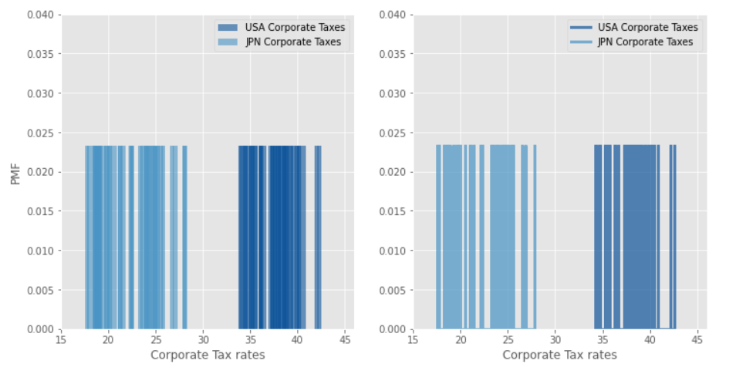
Corporate Tax PMF Plots
When I tried to Plot a difference, it was 0 because of uniform distribution

Slide 15
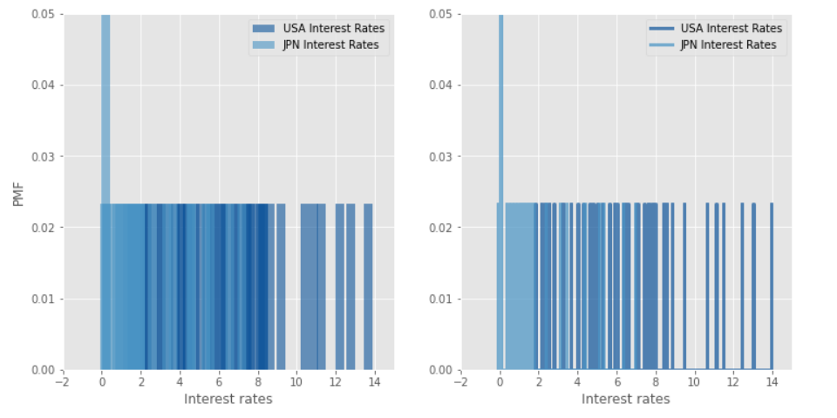
Interest Rate PMF Plots

Slide 16
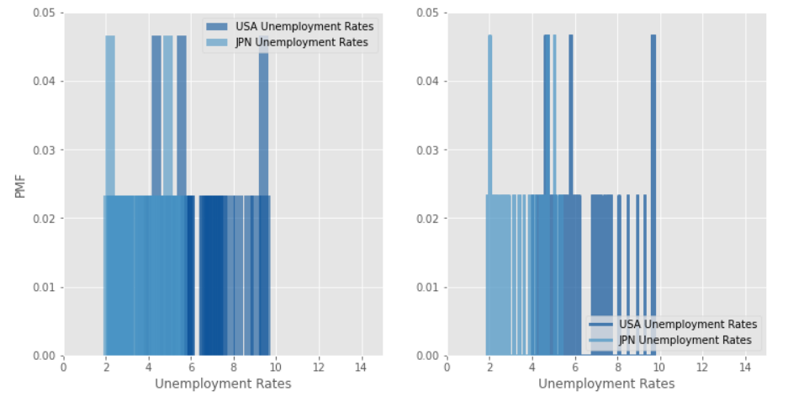
Unemployment Rates PMF Plots

Slide 17
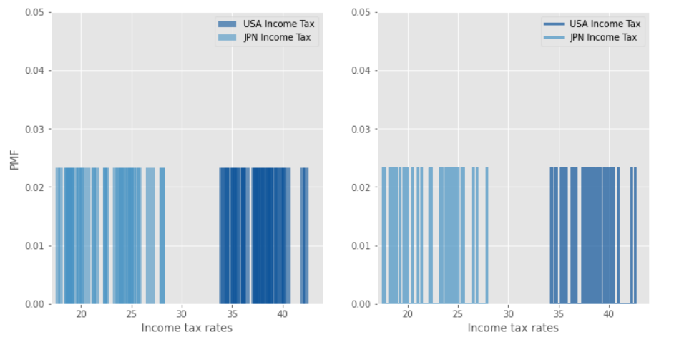
Income Tax PMF Plots

Slide 18
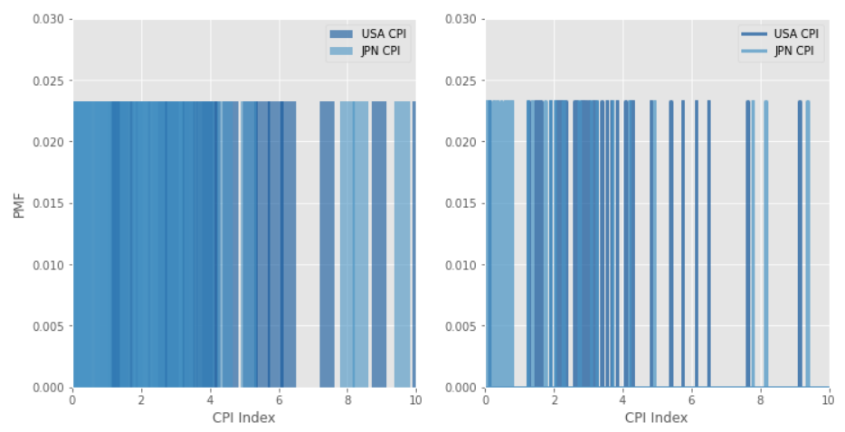
CPI PMF Plots

Slide 19
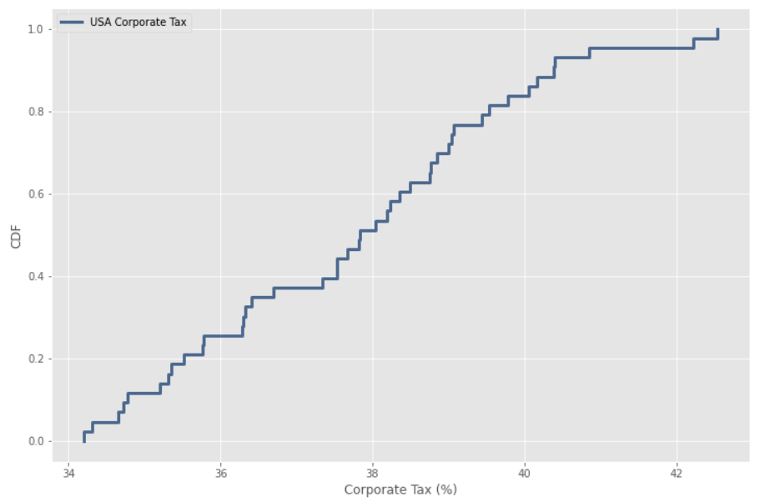
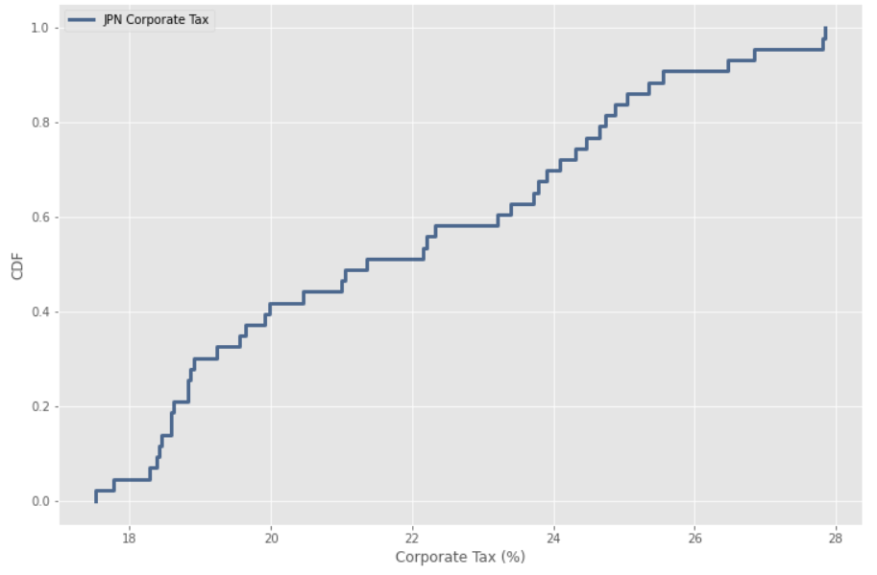
CDF Analysis
All of the variables are almost uniform distribution, which means each outcome has equal probability of occurring. That means they are random. Exception to this is Unemployment rates. Unemployment doesn’t have the same trend.

Slide 20
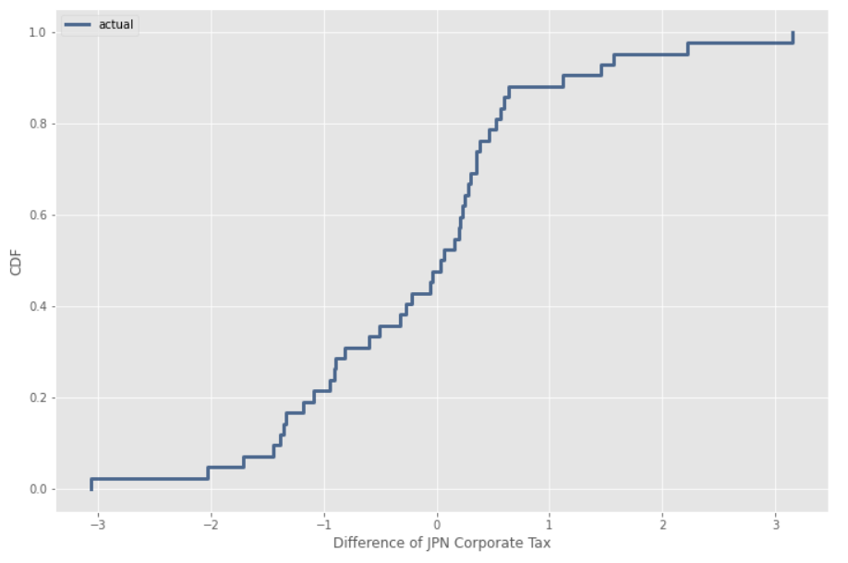
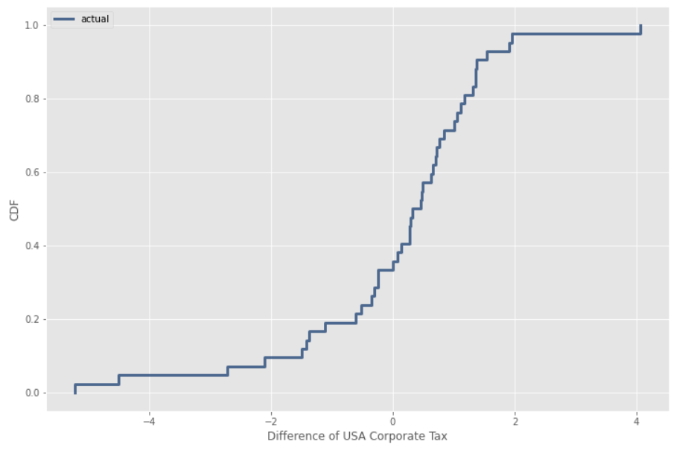
Exponential Distribution
I decided to apply Exponential Distribution because data event is equally likely to appear just like in uniform distribution, eqch one has equal probability of occuring.

Slide 21
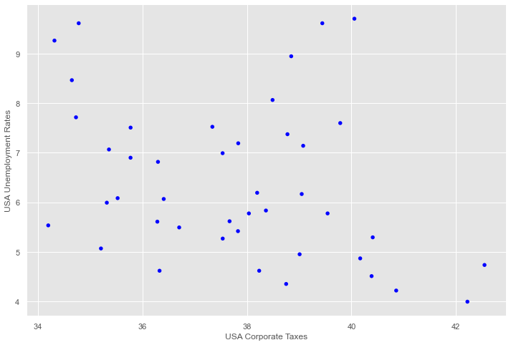
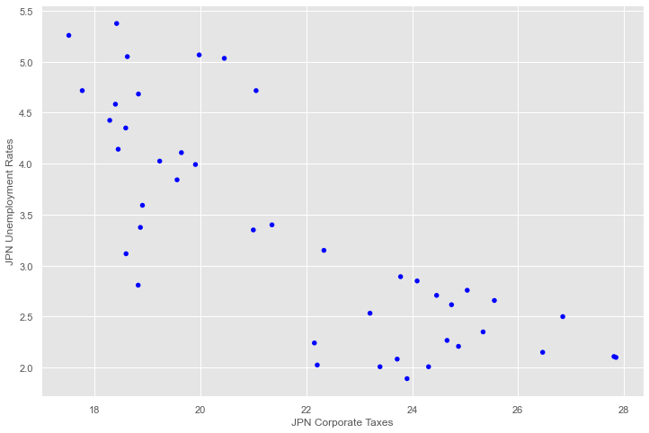
Relationship Analysis of Corporate Tax vs Unemployment
Both graphs for each country shows a negative relationship. However, US data points are more dispersed compared to Japan. Japan has a slightly strong relationship compare to USA.

Slide 22
Relationship Analysis of Corporate Tax vs Unemployment
Pearson's correlation for US Corporate tax vs. Unemployment is : -0.32
Spearmen’s correlation for US Corporate tax vs. Unemployment: -0.31
Covariance of US Corp Tax vs Unemployment rates: -1.04
Pearson correlation for JPN Corporate tax vs. Unemployment: -0.80
Spearman correlation for JPN Corporate tax vs. Unemployment: -0.78
Covariance of JPN Corp Tax vs Unemployment rates: -2.62
A negative covariance means that both variable deviates from the mean in opposite direction.
A negative r means both variables has negative relationship

Slide 23
Hypothesis Testing
Hypothesis testing for Mean difference.
For hypothesis testing, I decided to test the difference of mean between the unemployment rate, because Japan has lower tax rates, so my rationale is they should have a significant difference.
H0: There is no mean difference between the unemployment rate between the two countries
H1: There is a significant difference between the two country’s unemployment rate.
Results:
P-value = 0.0 <0.05. Therefore we reject the null Hypothesis and believe there is a difference between the two.

Slide 24
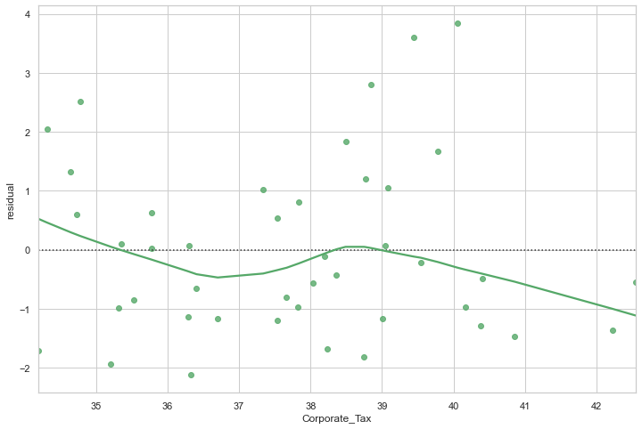
Regression Analysis for USA data
Linear regression Model for Unemployment rate vs. Corporate tax is:
Unemployment_Rate = 15.27 - 235*(Corporate_Tax)
R = -0.317
R^2 = 0.101

Slide 25
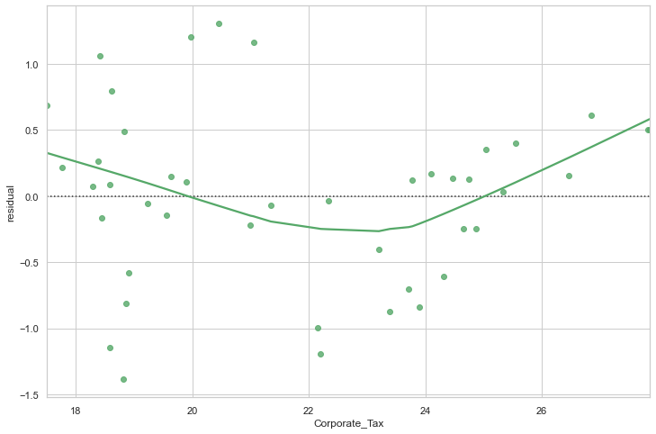
Regression Analysis for JPN data
Linear regression Model for Unemployment rate vs. Corporate tax is:
Unemployment_Rate = 9.61 - 0.287*(Corporate_Tax)
R = -0.804
R^2 = 0.607

Slide 26
Conclusion
Initially, the Question was Do tax cuts create jobs? This statement implies that as taxes gets lower, so does the unemployment rate. Unemployment rate is one indicator to measure jobs created, We should’ve seen some positive relationship. Though, there is a relationship between the two variables, it is negative and non-linear. The Covariance is also negative, stating that they both deviates in opposite direction. Therefore I conclude, taxes don’t really create jobs. Furthermore, when compared to JAPAN, who historically had lower tax rates, but had higher unemployment rates with a strong negative relationship, indicating that lower taxes causes more unemployment

